Slide 1

Movies on OTT Platforms
Power BI Dashboard
-Pravalika Ravalkol

Slide 2

Objectives
1
To analyze movies available across major OTT platforms.
2
To compare IMDb and Rotten Tomatoes ratings.
3
To study genre distribution and audience age categories.
4
To identify which countries produce more movies.
5
To identify releases by year.

Slide 3



Source
Movies on OTT Platforms – Kaggle Dataset
Dataset Overview
Total rows and columns
rows: 16744
columns: 16
Key columns used:
ID, Title, Year, Age, IMDb, Rotten Tomatoes, Netflix, Hulu, Prime Video, Disney+ , Type, Directors, Genres, Country, Language, Runtime

Slide 4
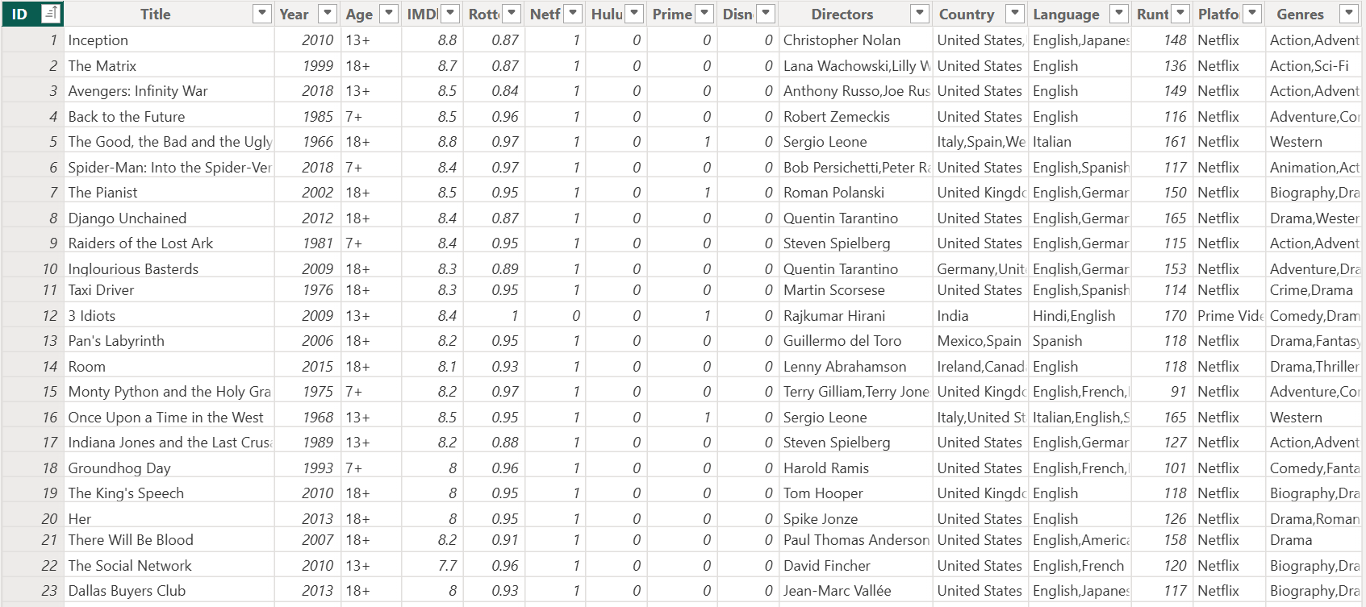
Dataset

Slide 5
Data Cleaning
Checked data formats for all columns to ensure consistency.
Deleted the Type column as it had only a single value (0).
Replaced blank cells in the Age column with “All”.
Merged all OTT platform columns (Netflix, Hulu, Prime Video, Disney+) into one Platform column using an IF-ELSE logic.
Filled blank IMDB ratings with the average rating.
Replaced blank Country values with “Unknown”.

Slide 6
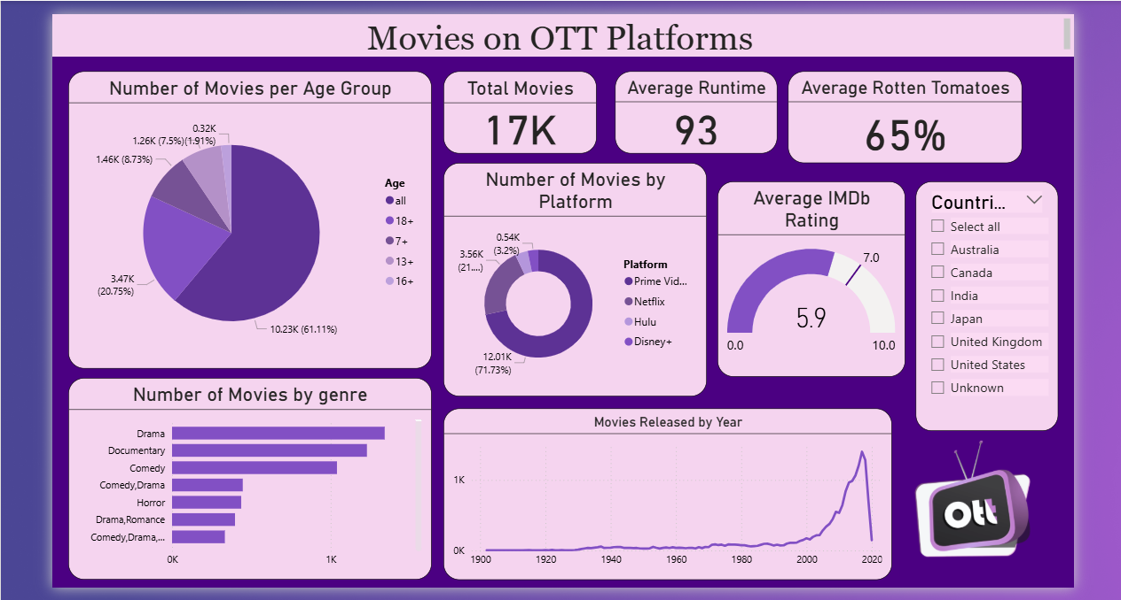

Slide 7
Key Insights
Most movies are for “All” age groups.
Prime Video has the largest movie collection (~71.73%).
The genres with the highest number of movies are Dramas, Documentaries, and Comedy.
Average IMDb rating: 5.9 | Average Rotten Tomatoes: 64%.
Movie releases increased sharply after 2000.
The United States produces the highest number of movies.

Slide 8
Thank you!
Pravalika Ravalkol
pravalikagoudr@gmail.com

